Slide 1

Brain Tumor Detection from MRI Images using CNNs
Presented by Group 11:
Abhay Singh Tomar - Roll No. 5
Amritanshu Chaudhary - Roll No. 36
Ansh Rajput - Roll No. 52
Adarsh Srivastava - Roll No. 13
Aryan Kumar Srivastava - Roll No. 69
Institute: Krishna Institutes of Engineering And Technology

Slide 2





Presentation Agenda
Problem & Intro
Understand the challenge and our approach.
Data & CNN Basics
Explore our dataset and core technology.
Methodology & Architecture
Steps taken and model design.
Training & Evaluation
How we trained and measured success.
Results & Conclusion
Key findings and future outlook.

Slide 3
Defining the Problem:
Objective: To develop an automated system using Convolutional Neural Networks (CNNs) that can accurately classify brain MRI images into tumor and no tumor categories.
Why is this important?
Brain tumors are among the most dangerous and life-threatening conditions.
Timely and accurate detection is essential for effective treatment and survival.
Manual analysis of MRI scans is time-consuming, requires expert radiologists, and is prone to human error and fatigue.
Key Challenges:
Brain MRI images may vary in size, intensity, orientation, and clarity.
Tumors can appear in different sizes, shapes, and locations.
Dataset imbalance (more normal images than tumor images) may affect performance.
Goal:
Build a deep learning model (CNN) that can automatically learn the features from MRI images and classify them with high accuracy and generalization.
Visualize the model’s performance using confusion matrices, ROC curves, and prediction samples, to ensure reliability and trust.

Slide 4
Introduction to Brain Tumor Detection
Brain tumors are life-threatening abnormal growths.
Early detection is crucial for treatment.
Manual diagnosis is time-consuming.
It is also prone to human error.
CNNs have shown state-of-the-art performance in medical image classification tasks.

Slide 5
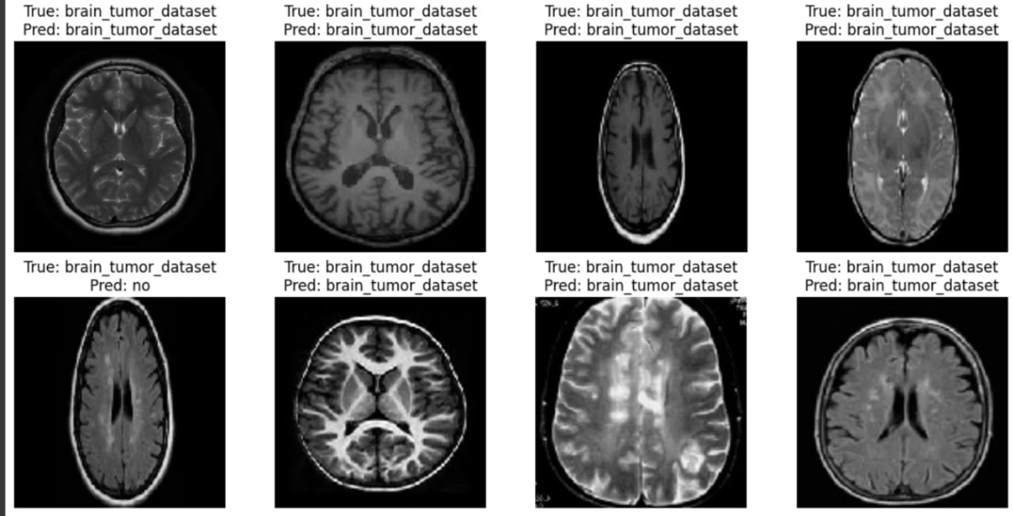
Data set:

Slide 6
Understanding Our Dataset
Source & Classes
Preprocessing Steps
Publicly available Brain MRI datasets.
Image resizing to 150x150 pixels.
Images classified as "Tumor" or "No Tumor."
Normalization of pixel values.
Train/Validation/Test split (70/15/15).

Slide 7
Convolutional Neural Network (CNN) Basics
CNNs are deep learning models particularly effective for image data.
They use convolutional layers to detect features like edges, shapes, textures.
Pooling layers reduce spatial dimensions.
Fully connected layers make the final classification.
CNNs learn hierarchical feature representations automatically.

Slide 8
Our Methodology Flow
Data Processing
Collection, cleaning, and preprocessing of MRI scans.
Model Building
Designing and implementing the CNN architecture.
Model Training
Training the CNN with labeled MRI data.
Evaluation
Assessing performance using various metrics.
Visualization
Displaying predictions and performance (Confusion Matrix, ROC).

Slide 9
Key Evaluation Metrics
Accuracy: Measures overall correctness
Precision: How many predicted tumors are actual tumors
Recall: How many actual tumors were correctly predicted
F1 Score: Harmonic mean of precision and recall
Confusion Matrix: Visual breakdown of TP, FP, TN, FN

Slide 10
Model Output and Results
27.5%
30%
Test Accuracy
Precision
Our model achieved high performance across all key metrics on unseen test data. Visual inspection of predictions further confirms its reliability.

Slide 11
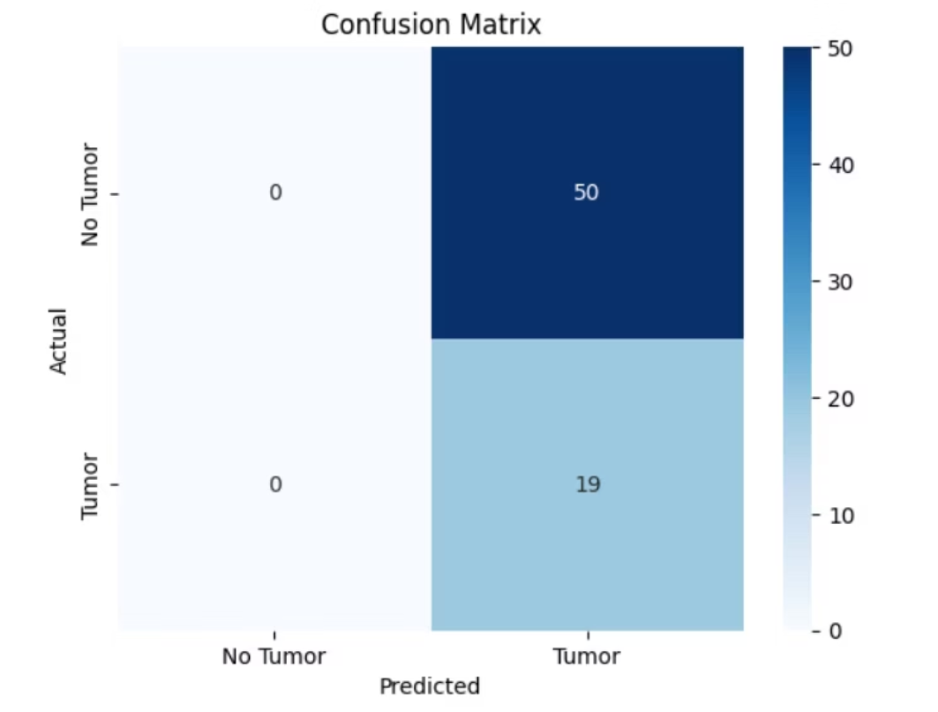
Confusion Matrix:

Slide 12
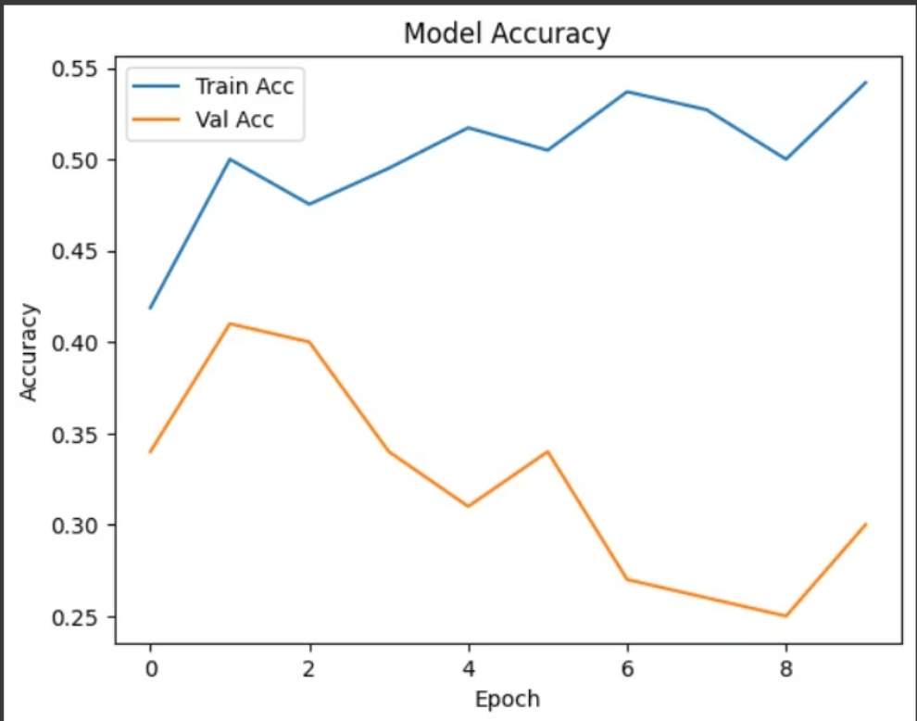
Model Accuracy:

Slide 13
Conclusion & Future Directions
CNNs can effectively detect brain tumors from MRI scans with high accuracy.
Visual inspection of predictions confirms reliable performance.
Further improvements possible with more data and data augmentation.
Could support radiologists in early detection and diagnosis.

Slide 14
Slide 13: References
Kaggle Dataset – Brain MRI Images for Brain Tumor Detection
"Deep Learning with Python" by François Chollet
Research Paper: “Brain Tumor Classification using CNNs” – IEEE Access
TensorFlow/Keras Documentation

